Slide 1

Welcome!

Slide 2

Real Estate Marketing for First.io
ADD A PICTURE!
Replace this text with a link to your GitHub repo
Alexander Appleton
Liang Chen Tetiana Dadakova
Mentor: Nathan Lande

Slide 3

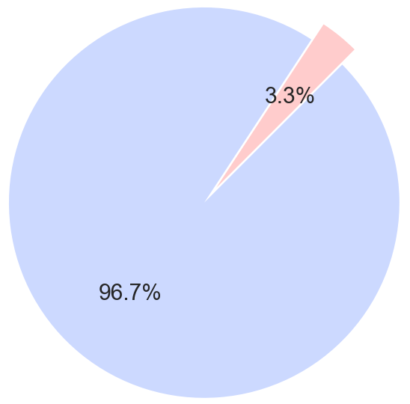



Finding a Needle in a Haystack
Our gigantic dataset
700+ features
~ 2,000,000 households in the state of NC
Two time records: 09/2016 and 06/2017
Our goal
Predict and validate who has moved between the period of 09/2016 and 06/2017
Computational tools (BIG challenge)
Cloud computing resources:
Distributed file system:
Distributed computing environment:
Movers
Stayers

Slide 4
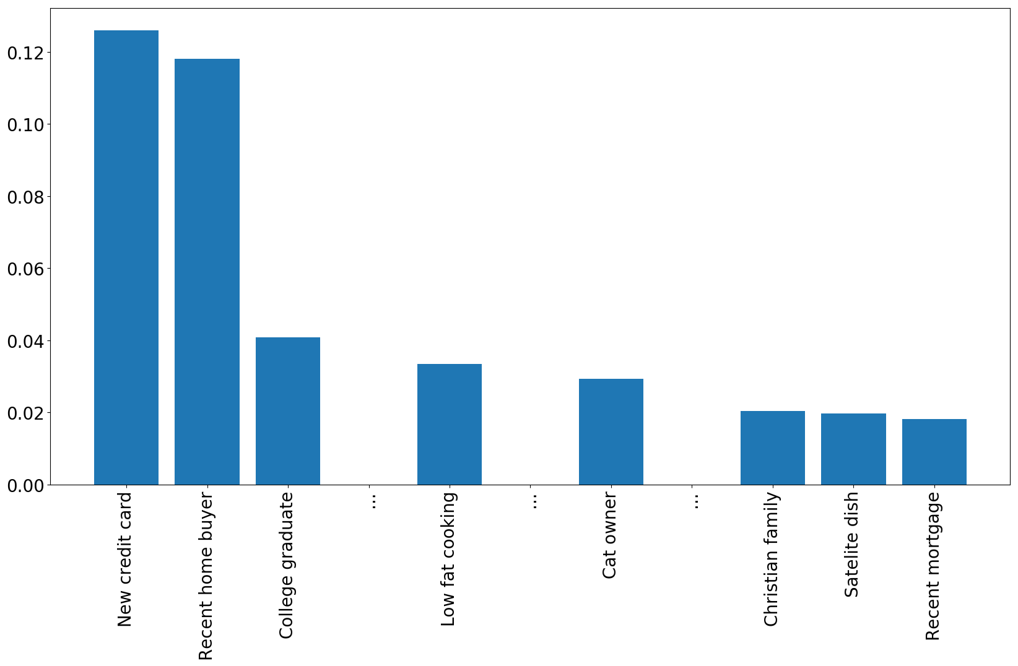
Explorative Analysis - Binary Features
Conditional
probabilities
Overall probability

Slide 5
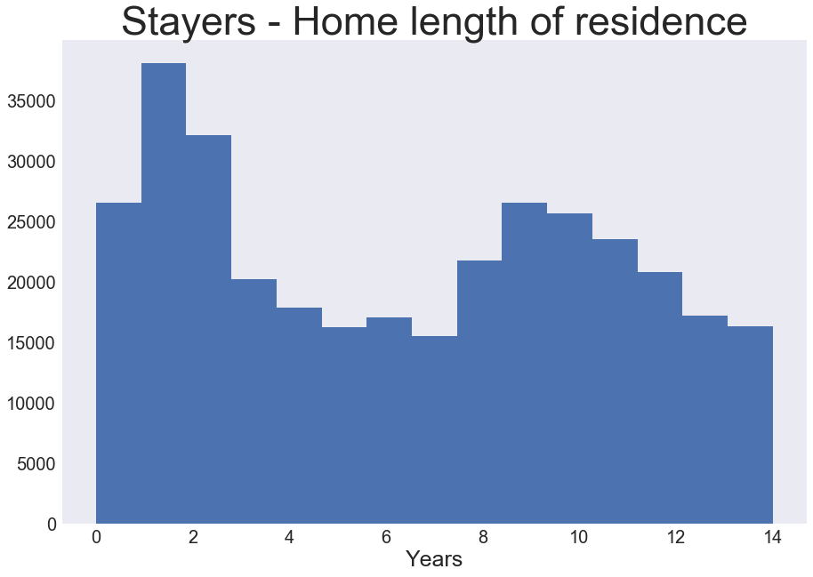
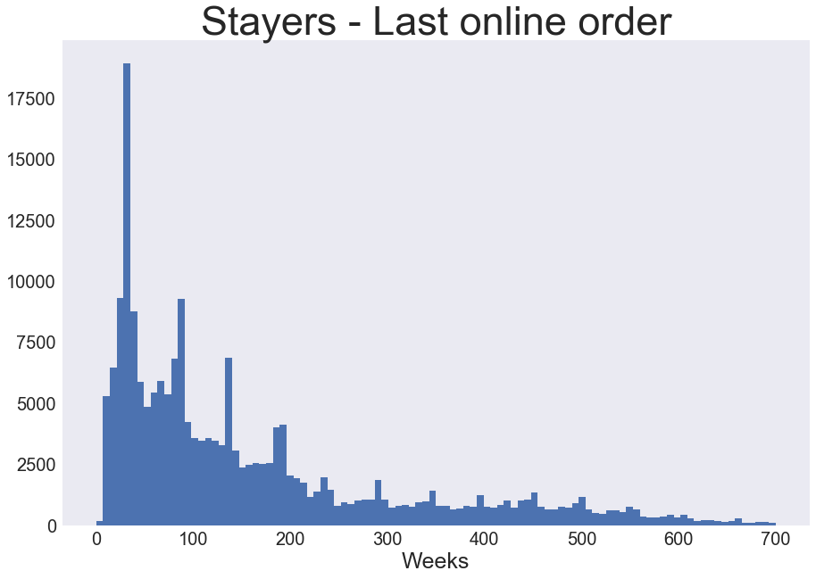
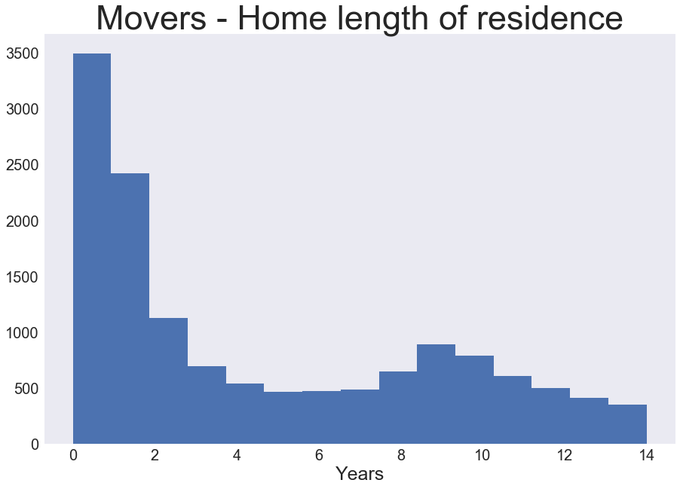
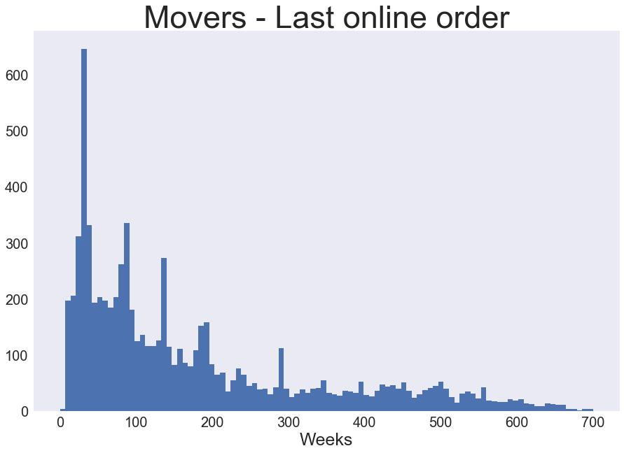
Explorative Analysis - Numerical Features

Slide 6
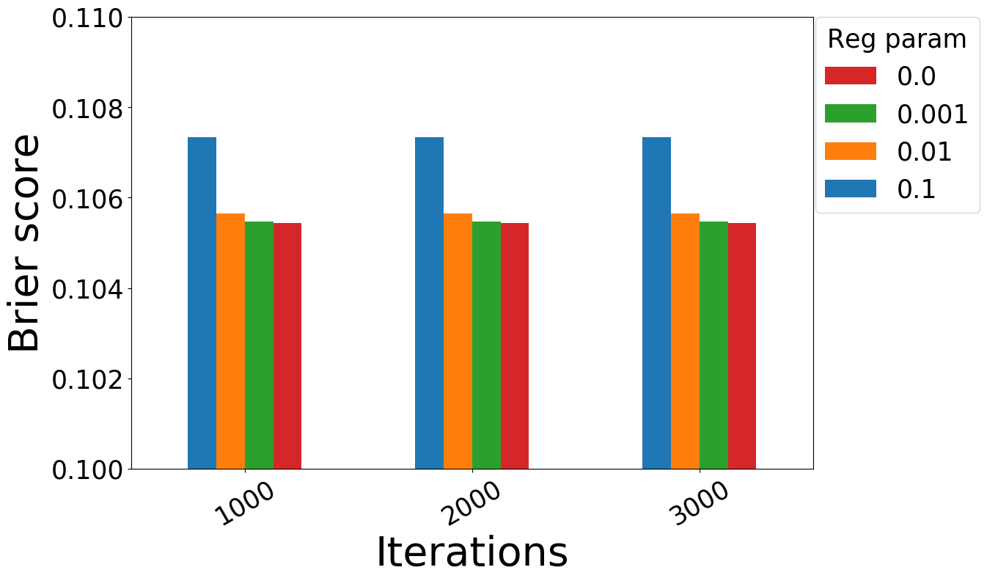
Hyperparameter Tuning - Logistic Regression
Hyperparameters
Regularization coefficient (λ)
L1/L2 regularization ratio (α)
# of iterations in gradient descent
Lessons Learned
No regularization is the best
LR model underfits the data
Need non-linear models for better performance
Model metric
Brier score = (probability - label)²

Slide 7
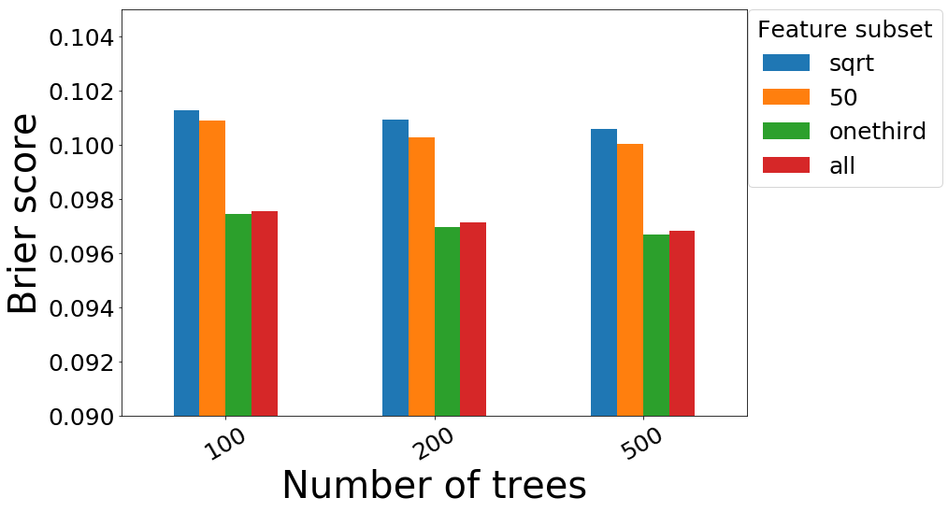
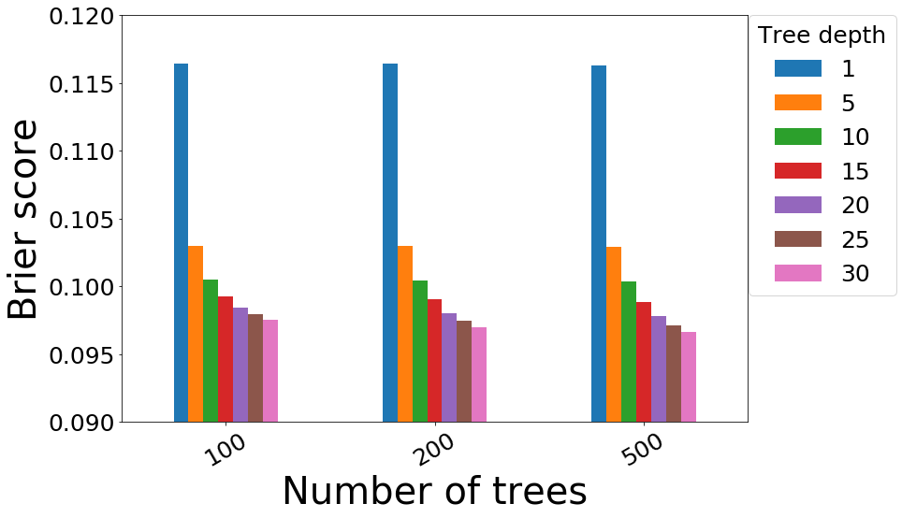
Hyperparameter Tuning - Random Forest
Hyperparameters
# of trees in the forest
Max depth of trees
# of features
Lessons Learned
Increasing tree depth and using ⅓ of total features are 2 critical factors in improving model performance
Increasing # of trees has no effect

Slide 8
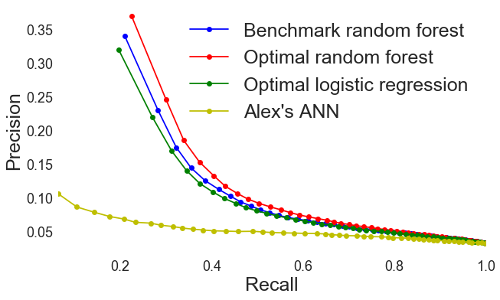
Measuring Model Performance - P/R curve
True positives
Precision =
All positive predictions
(model accuracy)
True positives
Recall =
Total positive targets
(model sensitivity)

Slide 9


Summary and Path Forward
Conclusion
Our optimized RF model achieves 7% improvement in Brier score over the production model
Immediate Impact
Insights already applied to the national model
Long Term Prospects
Moving decision-making is inherently a time dependent process. A time series model may offer unique perspectives and advantages
?

